Slide 1

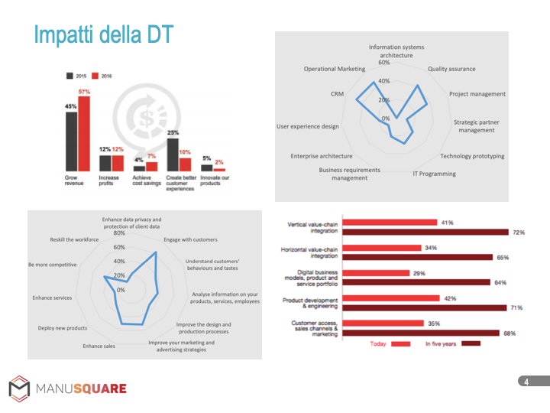
PMI NETWORK

Slide 2
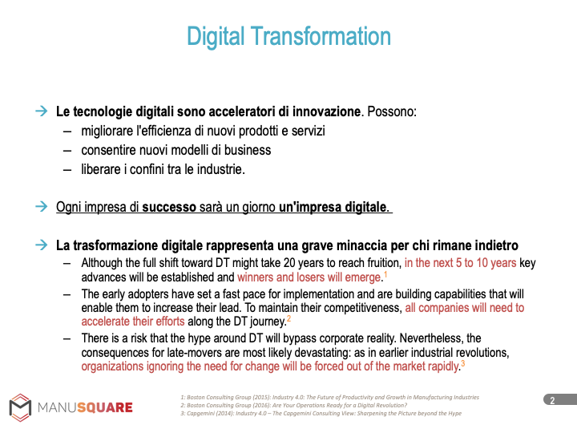
PMI NETWORK

Slide 3
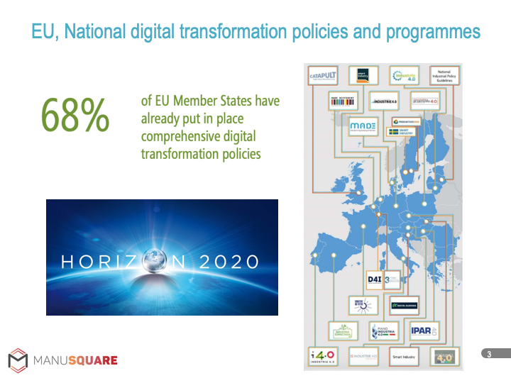
PMI NETWORK

Slide 4
PMI NETWORK

Slide 5
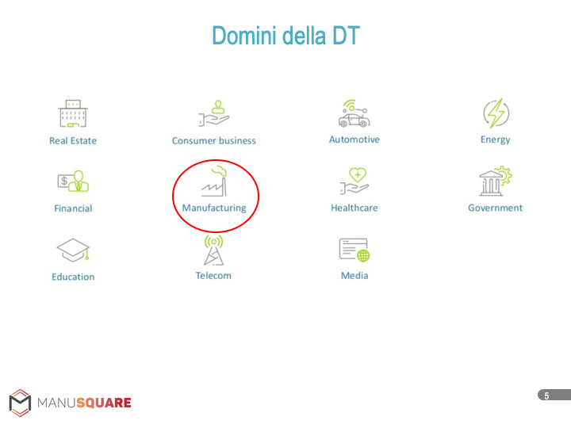
PMI NETWORK

Slide 6
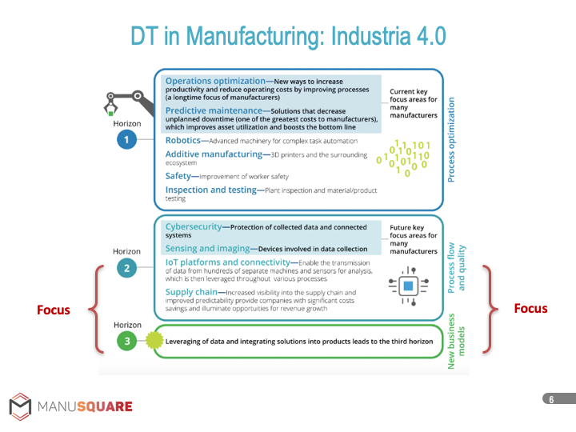
PMI NETWORK

Slide 7
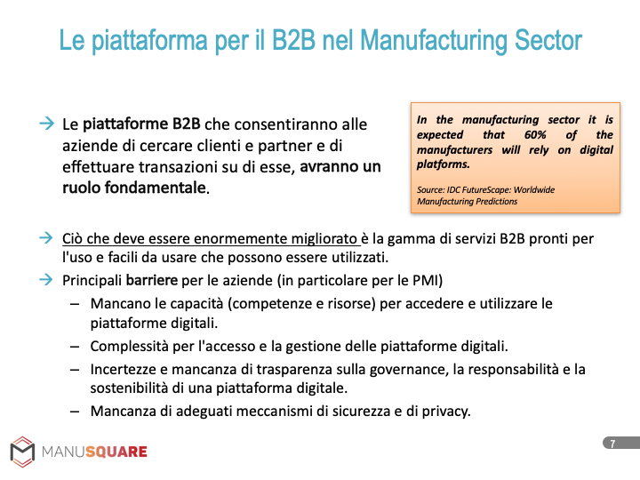
PMI NETWORK

Slide 8
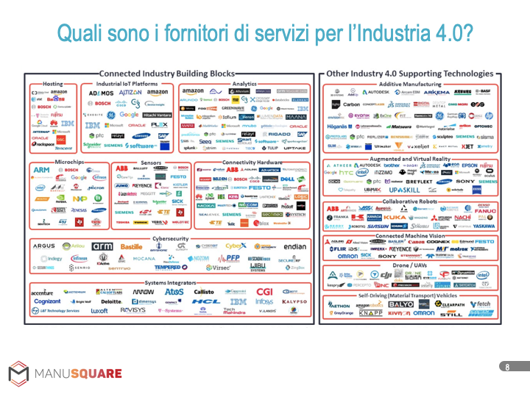
PMI NETWORK

Slide 9
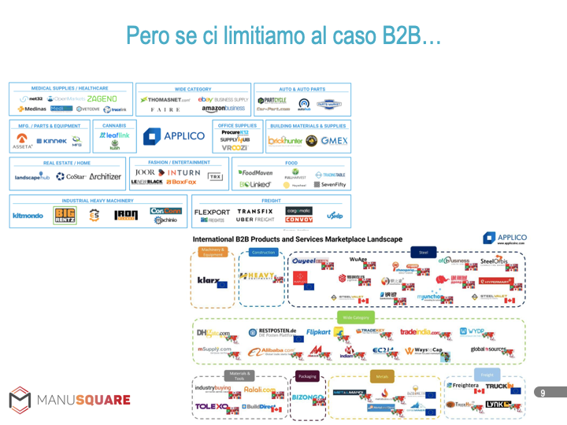
PMI NETWORK

Slide 10
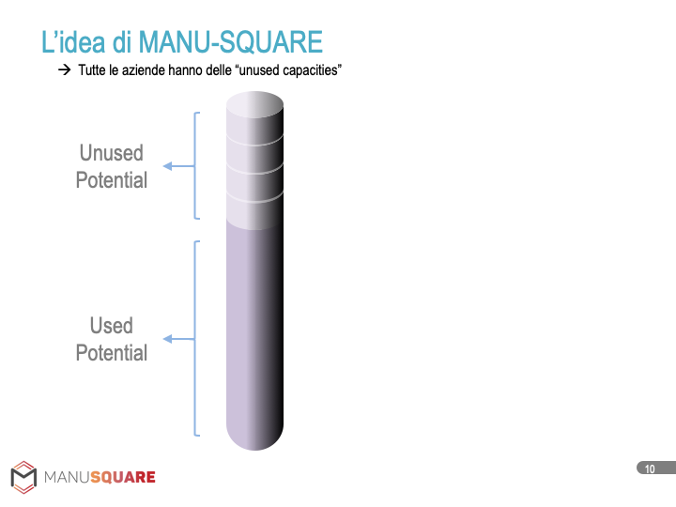
PMI NETWORK

Slide 11
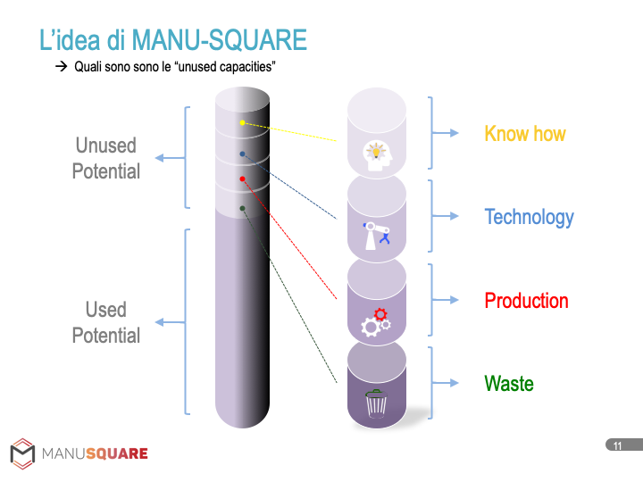
PMI NETWORK

Slide 12
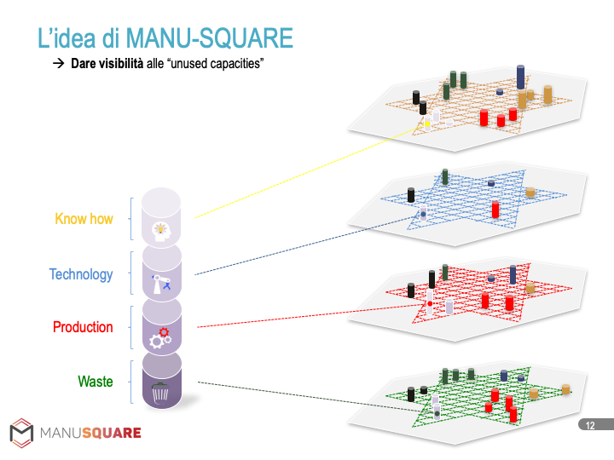
PMI NETWORK

Slide 13
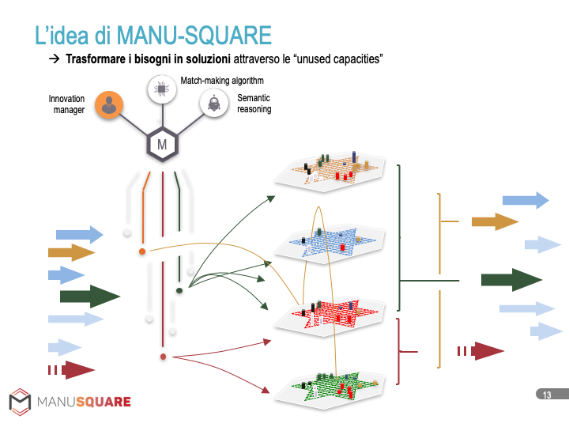
PMI NETWORK

Slide 14
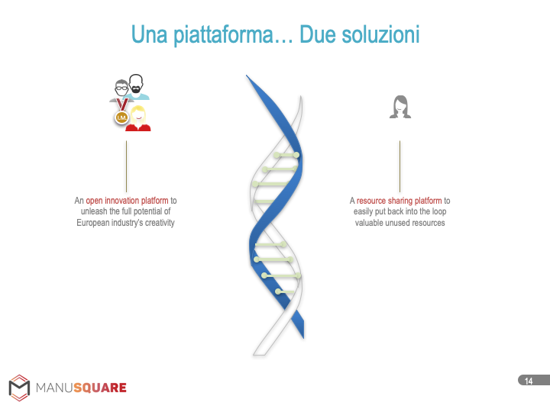
PMI NETWORK

Slide 15
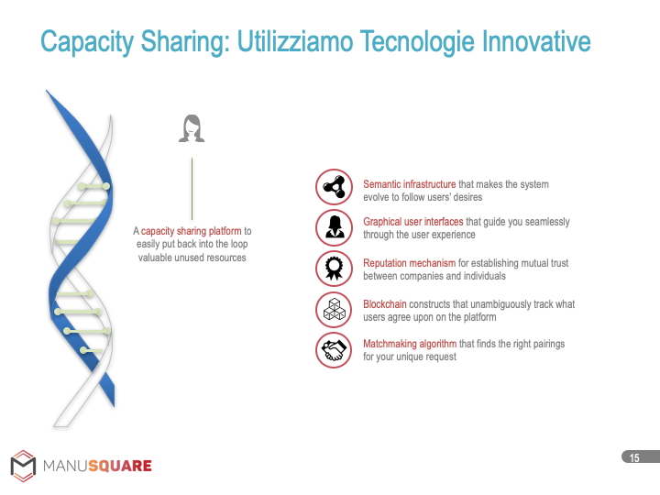
PMI NETWORK

Slide 16
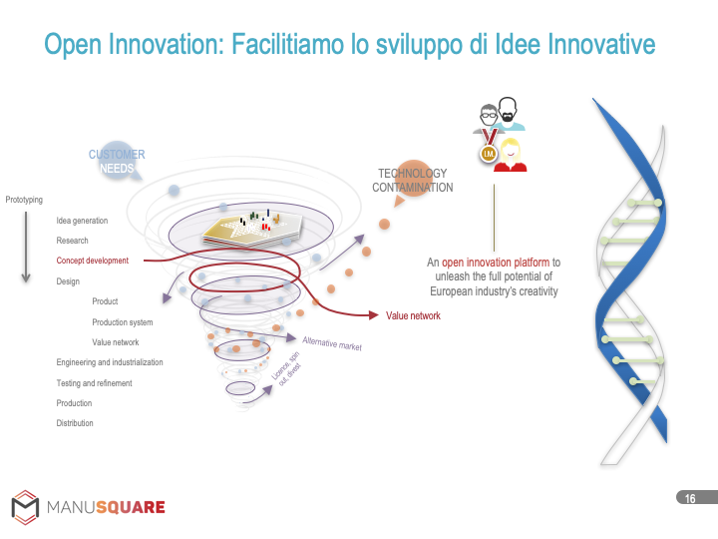
PMI NETWORK

Slide 17

PMI NETWORK

Slide 18

PMI NETWORK

Slide 19
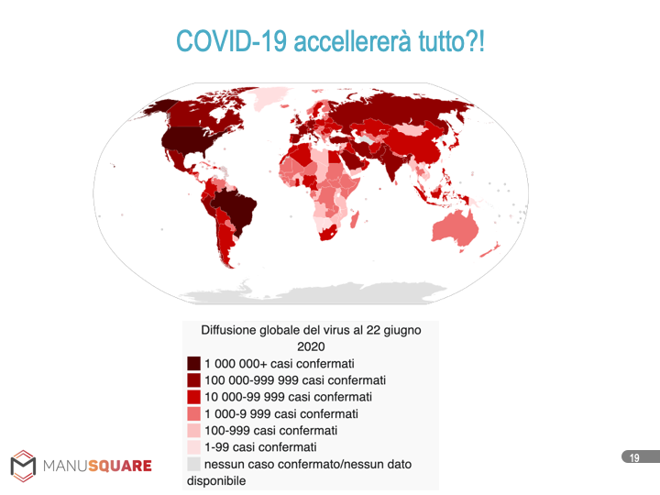
PMI NETWORK

Slide 20
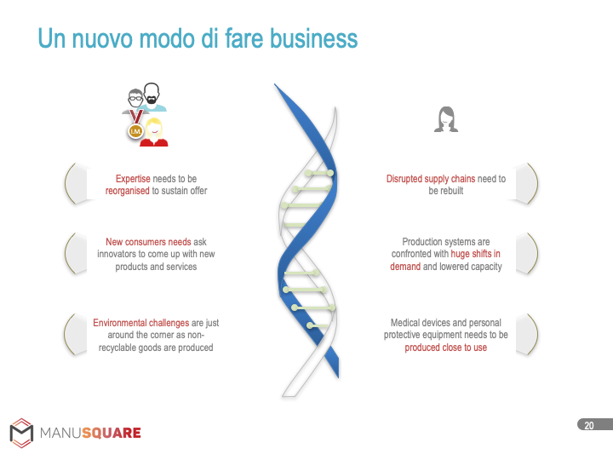
PMI NETWORK

Slide 21
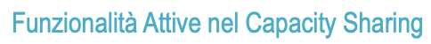






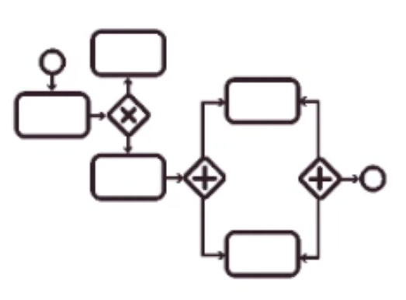

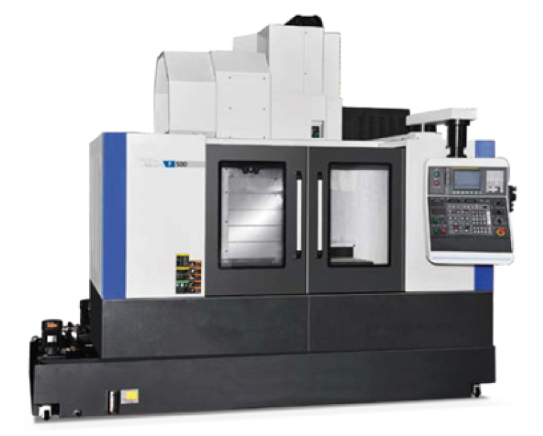










MVP
GUI, API &
EDM
Semantic Infrastructure
Matchmaking
Blockchain
Reputation Mechanism
Business Orchestrator
Supplier
Access to
MANU-SQUARE
Create a new resource
Create the quotation
Sign the agreement
Provide feedbacks
Customer
Access to
MANU-SQUARE
Create the RFQ
Select the most suitable suppliers
Receive all the quotations and select the best
Sign the agreement
Provide feedbacks

Slide 22
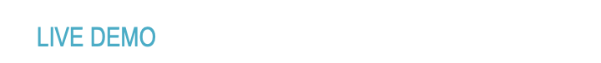
PMI NETWORK
VIDEO DEMO: https://drive.google.com/file/d/1c0fTWm9nzXqg-_jffSCDfFhYpZ4XIbhX/view

Slide 23
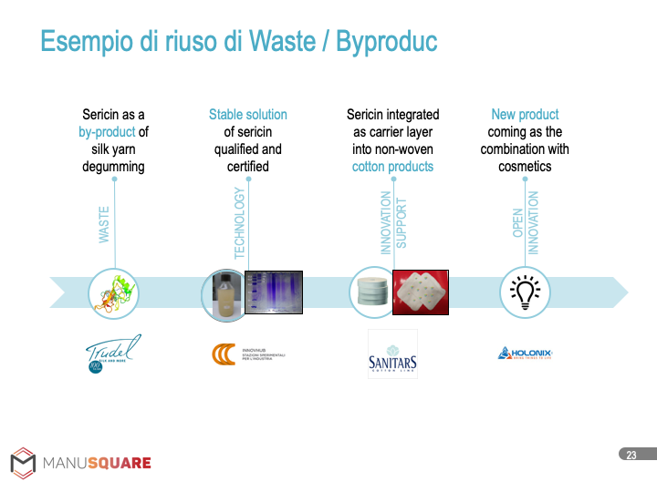
PMI NETWORK

Slide 24
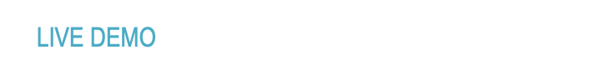
PMI NETWORK
LIVE Platform: https://platform.manusquare.eu/#/

Slide 25
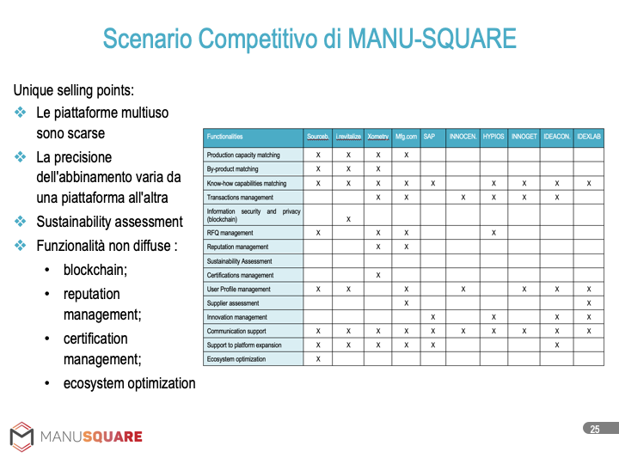
PMI NETWORK

Slide 26
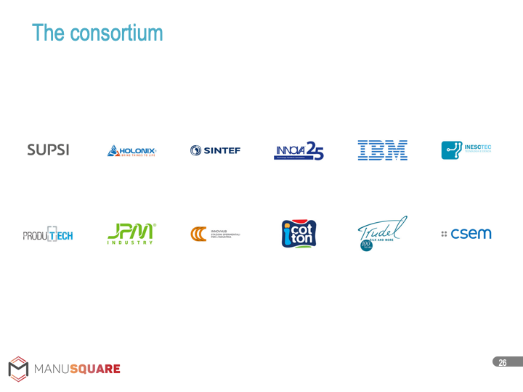
PMI NETWORK

Slide 27
APPROFONDIMENTI
Sito Web: https://www.manusquare.eu/
Documenti e Materiali: https://www.manusquare.eu/documents/
Accesso Piattaforma (Open Innovation): https://platform.manusquare.eu/#/
Video (Capacity Sharing): https://drive.google.com/file/d/1c0fTWm9nzXqg-_jffSCDfFhYpZ4XIbhX/view
YouTube Channel: https://drive.google.com/file/d/1c0fTWm9nzXqg-_jffSCDfFhYpZ4XIbhX/view
LinkedIn: https://www.linkedin.com/company/12616455/admin/
Twitter: https://twitter.com/eumanusquare

Slide 28
Domande a risposta multipla
In azienda, avete “Unused” capacities che vorreste/potreste condividere?
A Si, Know-how
B Si, Technology
C Si, Production
D Si, Waste
E No

Slide 29
Domande a risposta multipla
Usereste una piattaforma B2B per estendere/migliorare la vostra supply-chain?
A Si, senza condizioni
B Si, per scoprire nuovi partner/risorse utili
C Si, per creare e gestire le relazioni con i partner (nuovi e vecchi)
D Si, per sviluppare nuovi prodotti e modelli di business
E No

Slide 30
CONTATTI
Alessio Gugliotta
INNOVA srl
Email: a.gugliotta@innova-eu.net
Skype: gialessio
LinkedIn: https://www.linkedin.com/in/alessio-gugliotta-ba4b7132/

